Slide 1
Z-Axis Research
Katie Tanigawa
University of Victoria
PhD Student
katietan@uvic.ca
@katietani

Slide 2
Thank you!
Carrie Preston
Modernist Studies Association
Modernist Versions Project (MVP)
Maker Lab
University of Victoria

Slide 3
Outline
Preliminary definitions of Z-Axis Research
Past (data mounds)
Present (data tornadoes)
Future of Z-Axis research (versioning cities)

Slide 4
What is Z-Axis Research?
Highlights subjective encounters with texts
Uses 3D modeling and print fabrication methods
Embodies our data
Allows for the tactile engagement with an argument

Slide 5

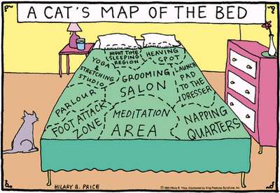
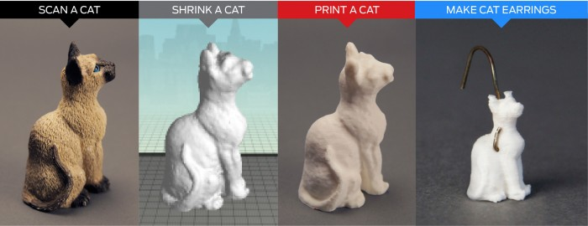
Combines traditional literary analysis, mapping and DH methods

Slide 6
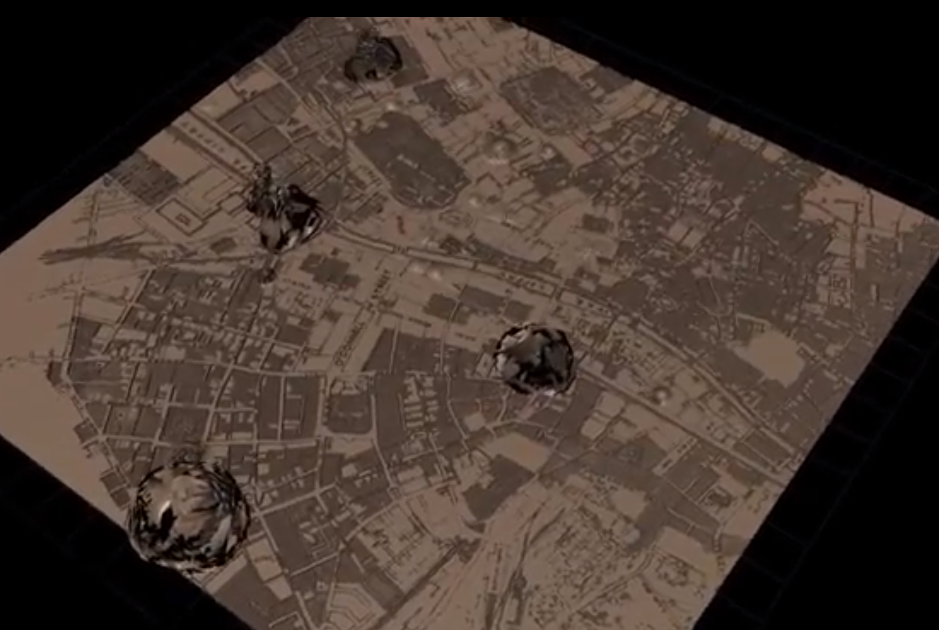
Past: Data Mounds

Slide 7
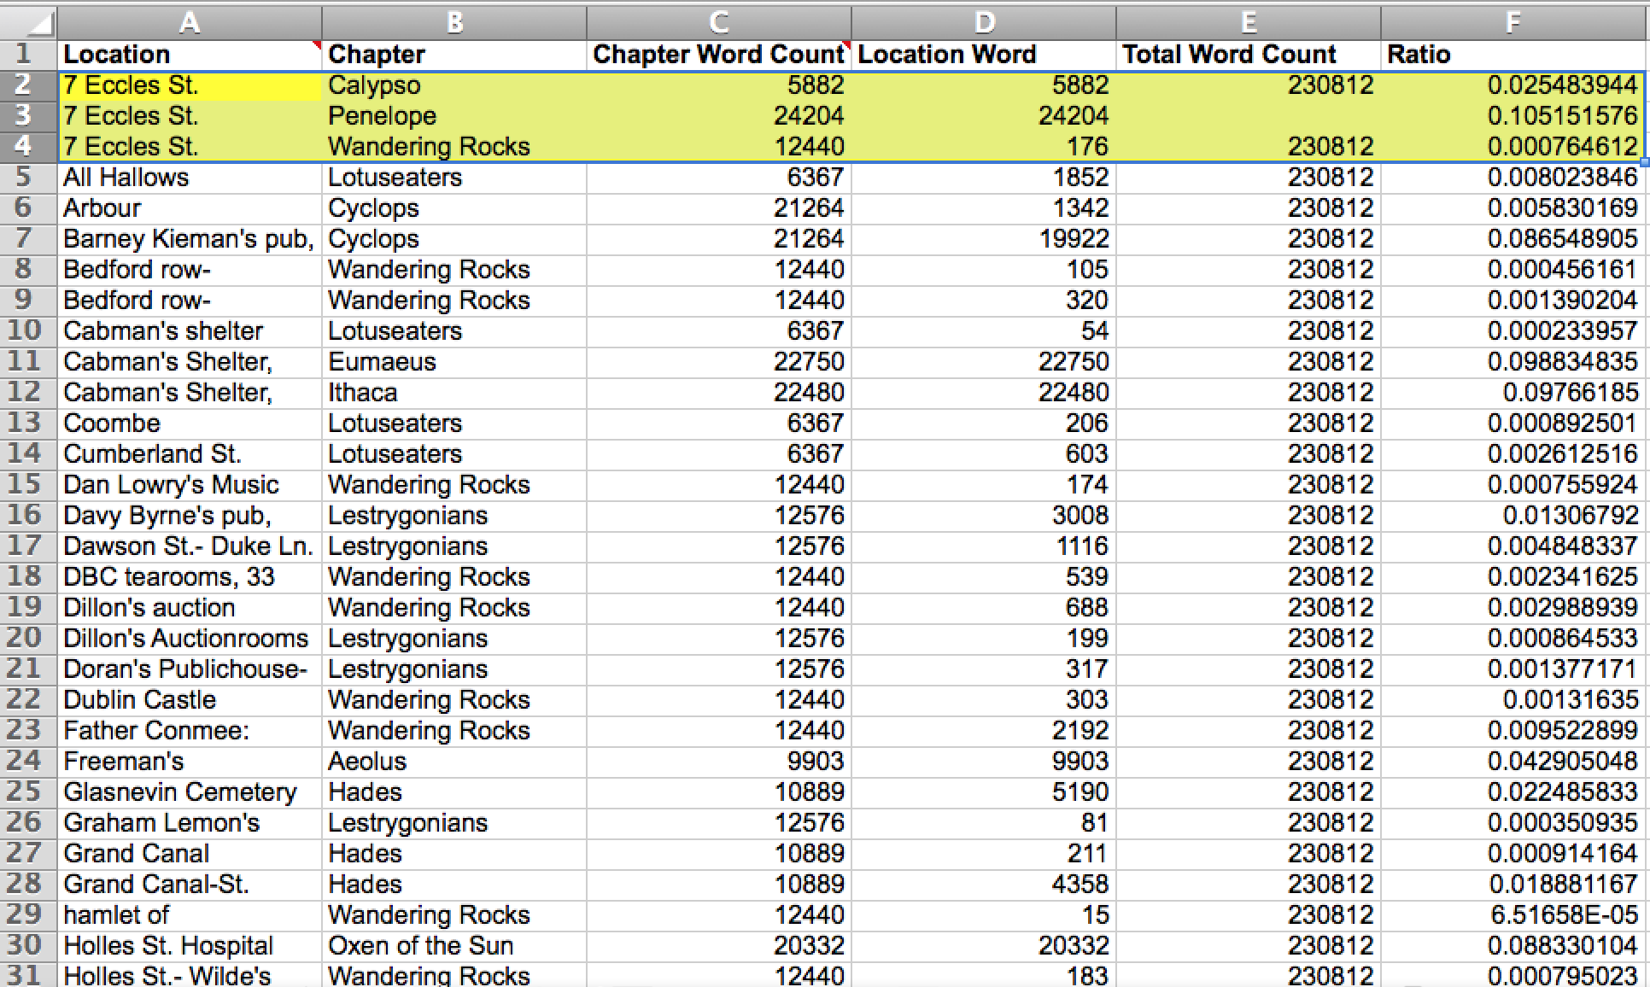
Data Model

Slide 9
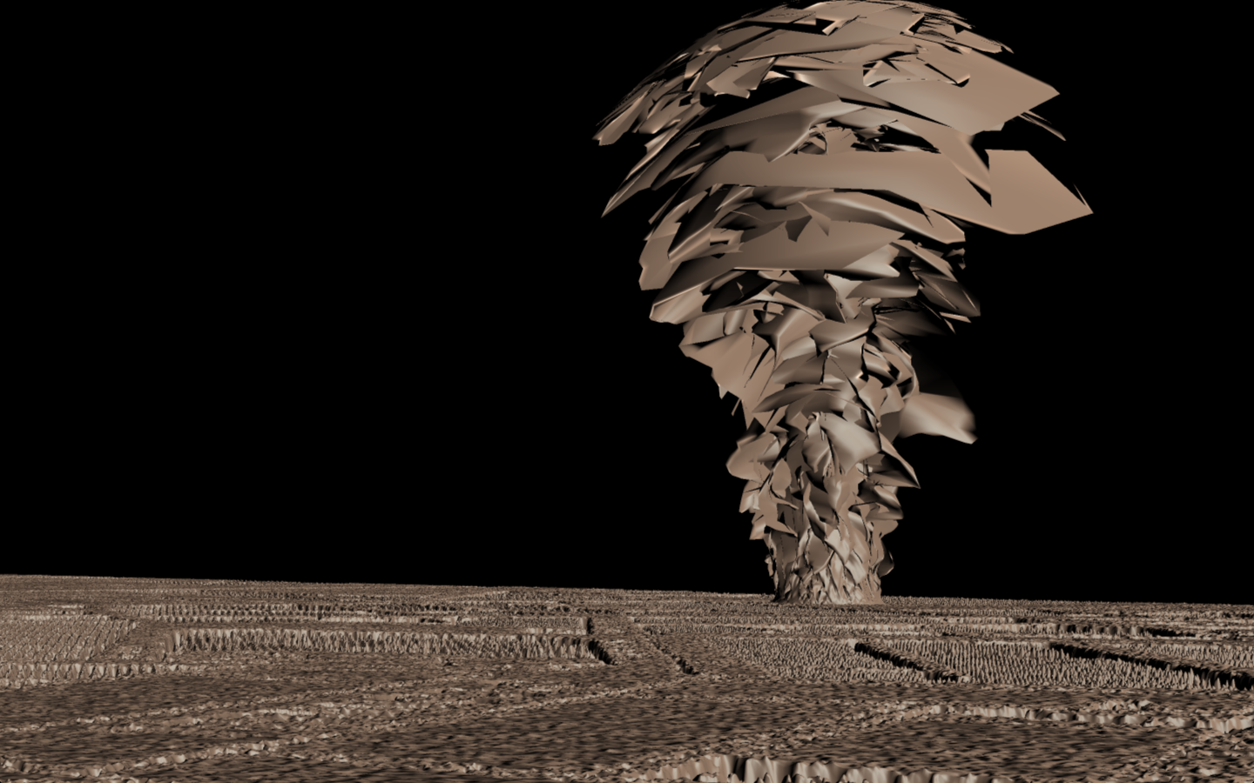
Present: Data Tornadoes

Slide 12
Modernist aesthetics of the research method
Distortion of space and time
Fragmentation of space and time
Fragmentation of the data representation

Slide 13
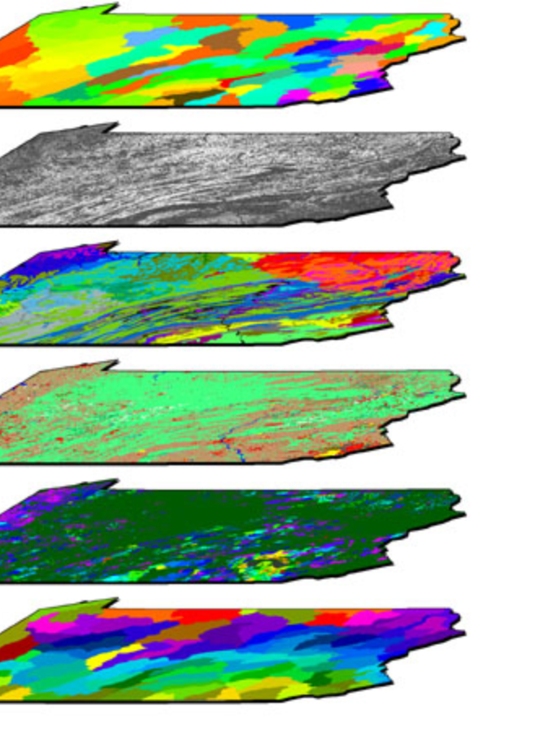
Future: Versioning Modernist Cities
+

Slide 14
Thank you!

